Slide 1
Chapter 17
Advanced Uses of Pointers
*
Copyright © 2008 W. W. Norton & Company.
All rights reserved.

Slide 2
Dynamic Storage Allocation
C’s data structures, including arrays, are normally fixed in size.
Fixed-size data structures can be a problem, since we’re forced to choose their sizes when writing a program.
Fortunately, C supports dynamic storage allocation: the ability to allocate storage during program execution.
Using dynamic storage allocation, we can design data structures that grow (and shrink) as needed.
*
Copyright © 2008 W. W. Norton & Company.
All rights reserved.

Slide 3
Dynamic Storage Allocation
Dynamic storage allocation is used most often for strings, arrays, and structures.
Dynamically allocated structures can be linked together to form lists, trees, and other data structures.
Dynamic storage allocation is done by calling a memory allocation function.
*
Copyright © 2008 W. W. Norton & Company.
All rights reserved.

Slide 4
Memory Allocation Functions
The <stdlib.h> header declares three memory allocation functions:
malloc —Allocates a block of memory but doesn’t initialize it.
calloc —Allocates a block of memory and clears it.
realloc —Resizes a previously allocated block of memory.
These functions return a value of type void * (a “generic” pointer).
*
Copyright © 2008 W. W. Norton & Company.
All rights reserved.

Slide 5
Null Pointers
If a memory allocation function can’t locate a memory block of the requested size, it returns a null pointer.
A null pointer is a special value that can be distinguished from all valid pointers.
After we’ve stored the function’s return value in a pointer variable, we must test to see if it’s a null pointer.
*
Copyright © 2008 W. W. Norton & Company.
All rights reserved.

Slide 6
Null Pointers
An example of testing malloc’s return value:
p = malloc(10000);
if (p == NULL) {
/* allocation failed; take appropriate action */
}
NULL is a macro (defined in various library headers) that represents the null pointer.
Some programmers combine the call of malloc with the NULL test:
if ((p = malloc(10000)) == NULL) {
/* allocation failed; take appropriate action */
}
*
Copyright © 2008 W. W. Norton & Company.
All rights reserved.

Slide 7
Null Pointers
Pointers test true or false in the same way as numbers.
All non-null pointers test true; only null pointers are false.
Instead of writing
if (p == NULL) …
we could write
if (!p) …
Instead of writing
if (p != NULL) …
we could write
if (p) …
*
Copyright © 2008 W. W. Norton & Company.
All rights reserved.

Slide 8
Dynamically Allocated Strings
Dynamic storage allocation is often useful for working with strings.
Strings are stored in character arrays, and it can be hard to anticipate how long these arrays need to be.
By allocating strings dynamically, we can postpone the decision until the program is running.
*
Copyright © 2008 W. W. Norton & Company.
All rights reserved.

Slide 9
Using malloc to Allocate Memory for a String
Prototype for the malloc function:
void *malloc(size_t size);
malloc allocates a block of size bytes and returns a pointer to it.
size_t is an unsigned integer type defined in the library.
*
Copyright © 2008 W. W. Norton & Company.
All rights reserved.

Slide 10
Using malloc to Allocate Memory for a String
A call of malloc that allocates memory for a string of n characters:
p = malloc(n + 1);
p is a char * variable.
Each character requires one byte of memory; adding 1 to n leaves room for the null character.
Some programmers prefer to cast malloc’s return value, although the cast is not required:
p = (char *) malloc(n + 1);
*
Copyright © 2008 W. W. Norton & Company.
All rights reserved.

Slide 11
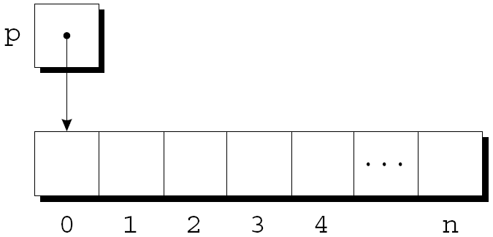
Using malloc to Allocate Memory for a String
Memory allocated using malloc isn’t cleared, so p will point to an uninitialized array of n + 1 characters:
*
Copyright © 2008 W. W. Norton & Company.
All rights reserved.

Slide 12
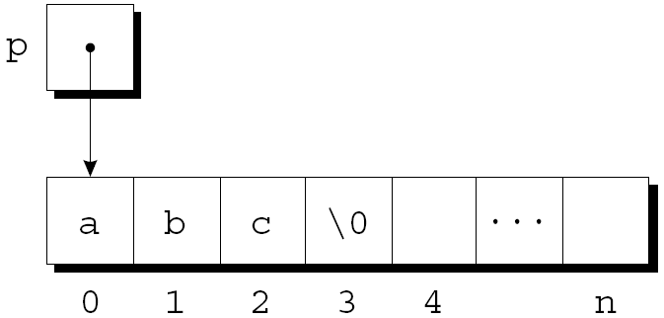
Using malloc to Allocate Memory for a String
Calling strcpy is one way to initialize this array:
strcpy(p, "abc");
The first four characters in the array will now be a, b, c, and \0:
*
Copyright © 2008 W. W. Norton & Company.
All rights reserved.

Slide 13
Using Dynamic Storage Allocation in String Functions
Dynamic storage allocation makes it possible to write functions that return a pointer to a “new” string.
Consider the problem of writing a function that concatenates two strings without changing either one.
The function will measure the lengths of the two strings to be concatenated, then call malloc to allocate the right amount of space for the result.
*
Copyright © 2008 W. W. Norton & Company.
All rights reserved.

Slide 14
Using Dynamic Storage Allocation in String Functions
char *concat(const char *s1, const char *s2)
{
char *result;
result = malloc(strlen(s1) + strlen(s2) + 1);
if (result == NULL) {
printf("Error: malloc failed in concat\n");
exit(EXIT_FAILURE);
}
strcpy(result, s1);
strcat(result, s2);
return result;
}
*
Copyright © 2008 W. W. Norton & Company.
All rights reserved.

Slide 15
Using Dynamic Storage Allocation in String Functions
A call of the concat function:
p = concat("abc", "def");
After the call, p will point to the string "abcdef", which is stored in a dynamically allocated array.
*
Copyright © 2008 W. W. Norton & Company.
All rights reserved.

Slide 16
Using Dynamic Storage Allocation in String Functions
Functions such as concat that dynamically allocate storage must be used with care.
When the string that concat returns is no longer needed, we’ll want to call the free function to release the space that the string occupies.
If we don’t, the program may eventually run out of memory.
free = deallocate
*
Copyright © 2008 W. W. Norton & Company.
All rights reserved.

Slide 17
Program: Printing a One-Month Reminder List (Revisited)
The remind2.c program is based on the remind.c program of Chapter 13, which prints a one-month list of daily reminders.
The original remind.c program stores reminder strings in a two-dimensional array of characters.
In the new program, the array will be one-dimensional; its elements will be pointers to dynamically allocated strings.
*
Copyright © 2008 W. W. Norton & Company.
All rights reserved.

Slide 18
Program: Printing a One-Month Reminder List (Revisited)
Advantages of switching to dynamically allocated strings:
Uses space more efficiently by allocating the exact number of characters needed to store a reminder.
Avoids calling strcpy to move existing reminder strings in order to make room for a new reminder.
Switching from a two-dimensional array to an array of pointers requires changing only eight lines of the program (shown in bold).
*
Copyright © 2008 W. W. Norton & Company.
All rights reserved.

Slide 19
remind2.c
/* Prints a one-month reminder list (dynamic string version) */
#include <stdio.h>
#include <stdlib.h>
#include <string.h>
#define MAX_REMIND 50 /* maximum number of reminders */
#define MSG_LEN 60 /* max length of reminder message */
int read_line(char str[], int n);
int main(void)
{
char *reminders[MAX_REMIND];
char day_str[3], msg_str[MSG_LEN+1];
int day, i, j, num_remind = 0;
*
Copyright © 2008 W. W. Norton & Company.
All rights reserved.

Slide 20
for (;;) {
if (num_remind == MAX_REMIND) {
printf("-- No space left --\n");
break;
}
printf("Enter day and reminder: ");
scanf("%2d", &day);
if (day == 0)
break;
sprintf(day_str, "%2d", day);
read_line(msg_str, MSG_LEN);
for (i = 0; i < num_remind; i++)
if (strcmp(day_str, reminders[i]) < 0)
break;
*
Copyright © 2008 W. W. Norton & Company.
All rights reserved.

Slide 21
for (j = num_remind; j > i; j--)
reminders[j] = reminders[j-1];
reminders[i] = malloc(2 + strlen(msg_str) + 1);
if (reminders[i] == NULL) {
printf("-- No space left --\n");
break;
}
strcpy(reminders[i], day_str);
strcat(reminders[i], msg_str);
num_remind++;
} // end for
printf("\nDay Reminder\n");
for (i = 0; i < num_remind; i++)
printf(" %s\n", reminders[i]);
return 0;
}
*
Copyright © 2008 W. W. Norton & Company.
All rights reserved.

Slide 22
int read_line(char str[], int n)
{
int ch, i = 0;
while ((ch = getchar()) != '\n')
if (i < n)
str[i++] = ch;
str[i] = '\0';
return i;
}
*
Copyright © 2008 W. W. Norton & Company.
All rights reserved.

Slide 23
Dynamically Allocated Arrays
Dynamically allocated arrays have the same advantages as dynamically allocated strings.
The close relationship between arrays and pointers makes a dynamically allocated array as easy to use as an ordinary array.
Although malloc can allocate space for an array, the calloc function is sometimes used instead, since it initializes the memory that it allocates.
The realloc function allows us to make an array “grow” or “shrink” as needed.
*
Copyright © 2008 W. W. Norton & Company.
All rights reserved.

Slide 24
Using malloc to Allocate Storage for an Array
Suppose a program needs an array of n integers, where n is computed during program execution.
We’ll first declare a pointer variable:
int *a;
Once the value of n is known, the program can call malloc to allocate space for the array:
a = malloc(n * sizeof(int));
Always use the sizeof operator to calculate the amount of space required for each element.
*
Copyright © 2008 W. W. Norton & Company.
All rights reserved.

Slide 25
Using malloc to Allocate Storage for an Array
We can now ignore the fact that a is a pointer and use it instead as an array name, thanks to the relationship between arrays and pointers in C.
For example, we could use the following loop to initialize the array that a points to:
for (i = 0; i < n; i++)
a[i] = 0;
We also have the option of using pointer arithmetic instead of subscripting to access the elements of the array.
*
Copyright © 2008 W. W. Norton & Company.
All rights reserved.

Slide 26
The calloc Function
The calloc function is an alternative to malloc.
Prototype for calloc:
void *calloc(size_t nmemb, size_t size);
Properties of calloc:
Allocates space for an array with nmemb elements, each of which is size bytes long.
Returns a null pointer if the requested space isn’t available.
Initializes allocated memory by setting all bits to 0.
*
Copyright © 2008 W. W. Norton & Company.
All rights reserved.

Slide 27
The calloc Function
A call of calloc that allocates space for an array of n integers:
a = calloc(n, sizeof(int));
By calling calloc with 1 as its first argument, we can allocate space for a data item of any type:
struct point { int x, y; } *p;
p = calloc(1, sizeof(struct point));
*
Copyright © 2008 W. W. Norton & Company.
All rights reserved.

Slide 28
The realloc Function
The realloc function can resize a dynamically allocated array.
Prototype for realloc:
void *realloc(void *ptr, size_t size);
ptr must point to a memory block obtained by a previous call of malloc, calloc, or realloc.
size represents the new size of the block, which may be larger or smaller than the original size.
*
Copyright © 2008 W. W. Norton & Company.
All rights reserved.

Slide 29
The realloc Function
Properties of realloc:
When it expands a memory block, realloc doesn’t initialize the bytes that are added to the block.
If realloc can’t enlarge the memory block as requested, it returns a null pointer; the data in the old memory block is unchanged.
If realloc is called with a null pointer as its first argument, it behaves like malloc.
If realloc is called with 0 as its second argument, it frees the memory block.
*
Copyright © 2008 W. W. Norton & Company.
All rights reserved.

Slide 30
The realloc Function
We expect realloc to be reasonably efficient:
When asked to reduce the size of a memory block, realloc should shrink the block “in place.”
realloc should always attempt to expand a memory block without moving it.
If it can’t enlarge a block, realloc will allocate a new block elsewhere, then copy the contents of the old block into the new one.
Once realloc has returned, be sure to update all pointers to the memory block in case it has been moved.
*
Copyright © 2008 W. W. Norton & Company.
All rights reserved.

Slide 31
Deallocating Storage
malloc and the other memory allocation functions obtain memory blocks from a storage pool known as the heap.
Calling these functions too often—or asking them for large blocks of memory—can exhaust the heap, causing the functions to return a null pointer.
To make matters worse, a program may allocate blocks of memory and then lose track of them, thereby wasting space.
*
Copyright © 2008 W. W. Norton & Company.
All rights reserved.

Slide 32
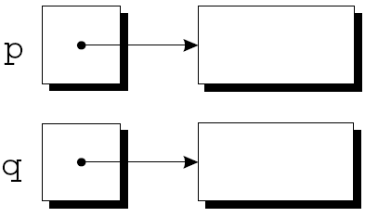
Deallocating Storage
Example:
p = malloc(…);
q = malloc(…);
p = q;
A snapshot after the first two statements have been executed:
*
Copyright © 2008 W. W. Norton & Company.
All rights reserved.

Slide 33
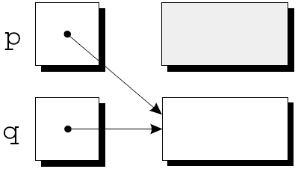
Deallocating Storage
After q is assigned to p, both variables now point to the second memory block:
There are no pointers to the first block, so we’ll never be able to use it again.
*
Copyright © 2008 W. W. Norton & Company.
All rights reserved.

Slide 34
Deallocating Storage
A block of memory that’s no longer accessible to a program is said to be garbage.
A program that leaves garbage behind has a memory leak.
Some languages provide a garbage collector that automatically locates and recycles garbage, but C doesn’t.
Instead, each C program is responsible for recycling its own garbage by calling the free function to release unneeded memory.
*
Copyright © 2008 W. W. Norton & Company.
All rights reserved.

Slide 35
The free Function
Prototype for free:
void free(void *ptr);
free will be passed a pointer to an unneeded memory block:
p = malloc(…);
q = malloc(…);
free(p);
p = q;
Calling free releases the block of memory that p points to.
*
Copyright © 2008 W. W. Norton & Company.
All rights reserved.

Slide 36
The “Dangling Pointer” Problem
Using free leads to a new problem: dangling pointers.
free(p) deallocates the memory block that p points to, but doesn’t change p itself.
If we forget that p no longer points to a valid memory block, chaos may ensue:
char *p = malloc(4);
…
free(p);
…
strcpy(p, "abc"); /*** WRONG ***/
Modifying the memory that p points to is a serious error.
*
Copyright © 2008 W. W. Norton & Company.
All rights reserved.

Slide 37
The “Dangling Pointer” Problem
Dangling pointers can be hard to spot, since several pointers may point to the same block of memory.
When the block is freed, all the pointers are left dangling.
*
Copyright © 2008 W. W. Norton & Company.
All rights reserved.

Slide 38
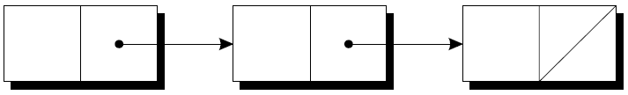
Linked Lists
Dynamic storage allocation is especially useful for building lists, trees, graphs, and other linked data structures.
A linked list consists of a chain of structures (called nodes), with each node containing a pointer to the next node in the chain:
The last node in the list contains a null pointer.
*
Copyright © 2008 W. W. Norton & Company.
All rights reserved.

Slide 39
Linked Lists
A linked list is more flexible than an array: we can easily insert and delete nodes in a linked list, allowing the list to grow and shrink as needed.
On the other hand, we lose the “random access” capability of an array:
Any element of an array can be accessed in the same amount of time.
Accessing a node in a linked list is fast if the node is close to the beginning of the list, slow if it’s near the end.
*
Copyright © 2008 W. W. Norton & Company.
All rights reserved.

Slide 40
Declaring a Node Type
To set up a linked list, we’ll need a structure that represents a single node.
A node structure will contain data (an integer in this example) plus a pointer to the next node in the list:
struct node {
int value; /* data stored in the node */
struct node *next; /* pointer to the next node */
};
node must be a tag, not a typedef name, or there would be no way to declare the type of next.
*
Copyright © 2008 W. W. Norton & Company.
All rights reserved.

Slide 41
Declaring a Node Type
Next, we’ll need a variable that always points to the first node in the list:
struct node *first = NULL;
Setting first to NULL indicates that the list is initially empty.
*
Copyright © 2008 W. W. Norton & Company.
All rights reserved.

Slide 42
Creating a Node
As we construct a linked list, we’ll create nodes one by one, adding each to the list.
Steps involved in creating a node:
Allocate memory for the node.
Store data in the node.
Insert the node into the list.
We’ll concentrate on the first two steps for now.
*
Copyright © 2008 W. W. Norton & Company.
All rights reserved.

Slide 43
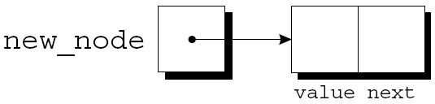
Creating a Node
When we create a node, we’ll need a variable that can point to the node temporarily:
struct node *new_node;
We’ll use malloc to allocate memory for the new node, saving the return value in new_node:
new_node = malloc(sizeof(struct node));
new_node now points to a block of memory just large enough to hold a node structure:
*
Copyright © 2008 W. W. Norton & Company.
All rights reserved.

Slide 44
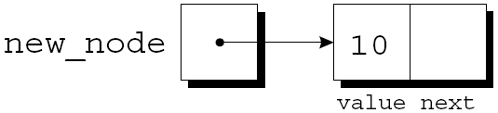
Creating a Node
Next, we’ll store data in the value member of the new node:
(*new_node).value = 10;
The resulting picture:
The parentheses around *new_node are mandatory because the . operator would otherwise take precedence over the * operator.
*
Copyright © 2008 W. W. Norton & Company.
All rights reserved.

Slide 45
The -> Operator
Accessing a member of a structure using a pointer is so common that C provides a special operator for this purpose.
This operator, known as right arrow selection, is a minus sign followed by >.
Using the -> operator, we can write
new_node->value = 10;
instead of
(*new_node).value = 10;
*
Copyright © 2008 W. W. Norton & Company.
All rights reserved.

Slide 46
The -> Operator
The -> operator produces an lvalue, so we can use it wherever an ordinary variable would be allowed.
A scanf example:
scanf("%d", &new_node->value);
The & operator is still required, even though new_node is a pointer.
*
Copyright © 2008 W. W. Norton & Company.
All rights reserved.

Slide 47
Inserting a Node at the Beginning of a Linked List
One of the advantages of a linked list is that nodes can be added at any point in the list.
However, the beginning of a list is the easiest place to insert a node.
Suppose that new_node is pointing to the node to be inserted, and first is pointing to the first node in the linked list.
*
Copyright © 2008 W. W. Norton & Company.
All rights reserved.

Slide 48
Inserting a Node at the Beginning of a Linked List
It takes two statements to insert the node into the list.
The first step is to modify the new node’s next member to point to the node that was previously at the beginning of the list:
new_node->next = first;
The second step is to make first point to the new node:
first = new_node;
These statements work even if the list is empty.
*
Copyright © 2008 W. W. Norton & Company.
All rights reserved.

Slide 49
Inserting a Node at the Beginning of a Linked List
Let’s trace the process of inserting two nodes into an empty list.
We’ll insert a node containing the number 10 first, followed by a node containing 20.
*
Copyright © 2008 W. W. Norton & Company.
All rights reserved.

Slide 50
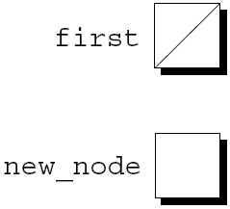
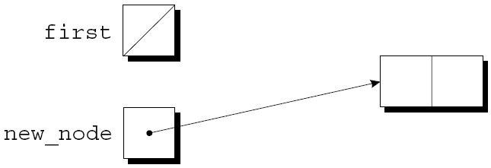
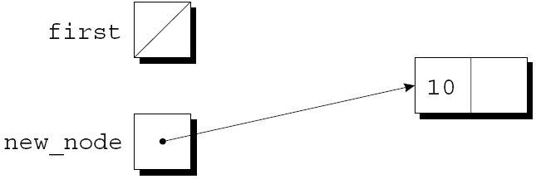
Inserting a Node at the Beginning of a Linked List
first = NULL;
new_node =
malloc(sizeof(struct node));
new_node->value = 10;
*
Copyright © 2008 W. W. Norton & Company.
All rights reserved.

Slide 51
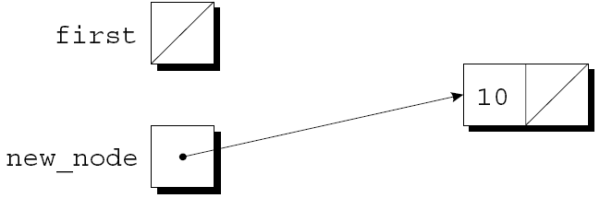
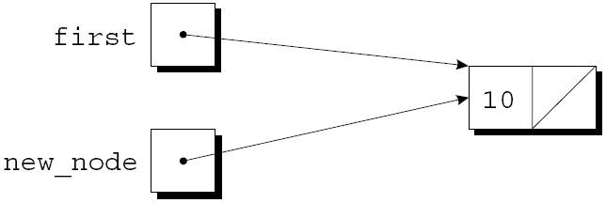
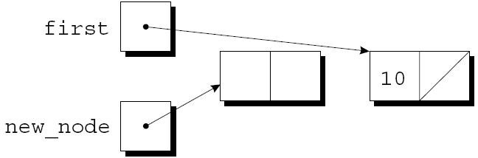
Inserting a Node at the Beginning of a Linked List
new_node->next = first;
first = new_node;
new_node =
malloc(sizeof(struct node));
*
Copyright © 2008 W. W. Norton & Company.
All rights reserved.

Slide 52
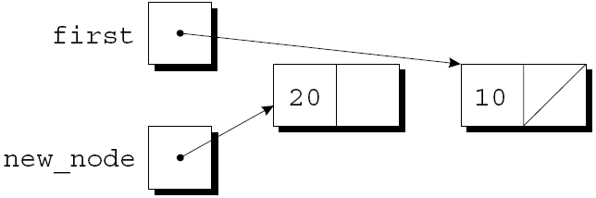
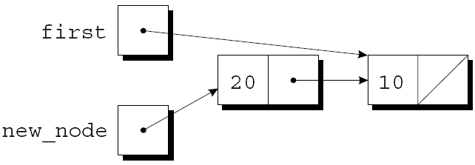
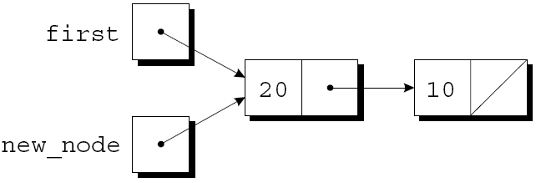
Inserting a Node at the Beginning of a Linked List
new_node->value = 20;
new_node->next = first;
first = new_node;
*
Copyright © 2008 W. W. Norton & Company.
All rights reserved.

Slide 53
Inserting a Node at the Beginning of a Linked List
A function that inserts a node containing n into a linked list, which pointed to by list:
struct node *add_to_list(struct node *list, int n)
{
struct node *new_node;
new_node = malloc(sizeof(struct node));
if (new_node == NULL) {
printf("Error: malloc failed in add_to_list\n");
exit(EXIT_FAILURE);
}
new_node->value = n;
new_node->next = list;
return new_node;
}
*
Copyright © 2008 W. W. Norton & Company.
All rights reserved.

Slide 54
Inserting a Node at the Beginning of a Linked List
Note that add_to_list returns a pointer to the newly created node (now at the beginning of the list).
When we call add_to_list, we’ll need to store its return value into first:
first = add_to_list(first, 10);
first = add_to_list(first, 20);
Getting add_to_list to update first directly, rather than return a new value for first, turns out to be tricky.
*
Copyright © 2008 W. W. Norton & Company.
All rights reserved.

Slide 55
Inserting a Node at the Beginning of a Linked List
A function that uses add_to_list to create a linked list containing numbers entered by the user:
struct node *read_numbers(void)
{
struct node *first = NULL;
int n;
printf("Enter a series of integers (0 to terminate): ");
for (;;) {
scanf("%d", &n);
if (n == 0)
return first;
first = add_to_list(first, n);
}
}
The numbers will be in reverse order within the list.
*
Copyright © 2008 W. W. Norton & Company.
All rights reserved.

Slide 56
Searching a Linked List
Although a while loop can be used to search a list, the for statement is often superior.
A loop that visits the nodes in a linked list, using a pointer variable p to keep track of the “current” node:
for (p = first; p != NULL; p = p->next)
…
A loop of this form can be used in a function that searches a list for an integer n.
*
Copyright © 2008 W. W. Norton & Company.
All rights reserved.

Slide 57
Searching a Linked List
If it finds n, the function will return a pointer to the node containing n; otherwise, it will return a null pointer.
An initial version of the function:
struct node *search_list(struct node *list, int n)
{
struct node *p;
for (p = list; p != NULL; p = p->next)
if (p->value == n)
return p;
return NULL;
}
*
Copyright © 2008 W. W. Norton & Company.
All rights reserved.

Slide 58
Searching a Linked List
There are many other ways to write search_list.
One alternative is to eliminate the p variable, instead using list itself to keep track of the current node:
struct node *search_list(struct node *list, int n)
{
for (; list != NULL; list = list->next)
if (list->value == n)
return list;
return NULL;
}
Since list is a copy of the original list pointer, there’s no harm in changing it within the function.
*
Copyright © 2008 W. W. Norton & Company.
All rights reserved.

Slide 59
Searching a Linked List
Another alternative:
struct node *search_list(struct node *list, int n)
{
for (; list != NULL && list->value != n;
list = list->next)
;
return list;
}
Since list is NULL if we reach the end of the list, returning list is correct even if we don’t find n.
*
Copyright © 2008 W. W. Norton & Company.
All rights reserved.

Slide 60
Searching a Linked List
This version of search_list might be a bit clearer if we used a while statement:
struct node *search_list(struct node *list, int n)
{
while (list != NULL && list->value != n)
list = list->next;
return list;
}
*
Copyright © 2008 W. W. Norton & Company.
All rights reserved.

Slide 61
Deleting a Node from a Linked List
A big advantage of storing data in a linked list is that we can easily delete nodes.
Deleting a node involves three steps:
Locate the node to be deleted.
Alter the previous node so that it “bypasses” the deleted node.
Call free to reclaim the space occupied by the deleted node.
Step 1 is harder than it looks, because step 2 requires changing the previous node.
There are various solutions to this problem.
*
Copyright © 2008 W. W. Norton & Company.
All rights reserved.

Slide 62
Deleting a Node from a Linked List
The “trailing pointer” technique involves keeping a pointer to the previous node (prev) as well as a pointer to the current node (cur).
Assume that list points to the list to be searched and n is the integer to be deleted.
A loop that implements step 1:
for (cur = list, prev = NULL;
cur != NULL && cur->value != n;
prev = cur, cur = cur->next)
;
When the loop terminates, cur points to the node to be deleted and prev points to the previous node.
*
Copyright © 2008 W. W. Norton & Company.
All rights reserved.

Slide 63
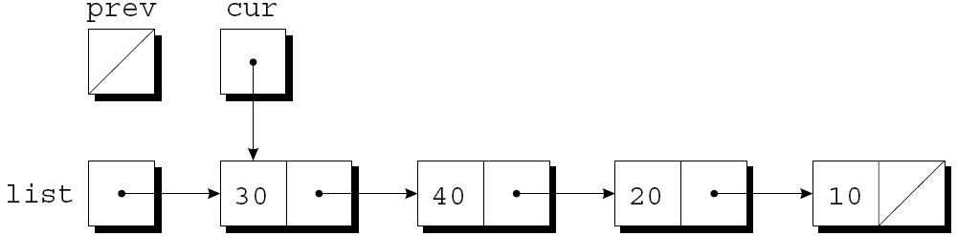
Deleting a Node from a Linked List
Assume that list has the following appearance and n is 20:
After cur = list, prev = NULL has been executed:
*
Copyright © 2008 W. W. Norton & Company.
All rights reserved.

Slide 64
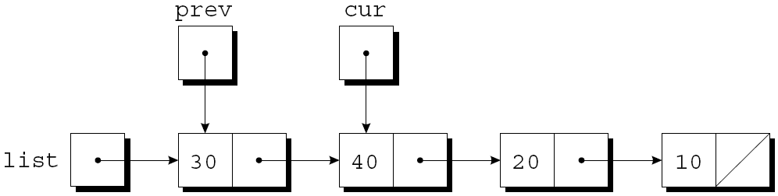
Deleting a Node from a Linked List
The test cur != NULL && cur->value != n is true, since cur is pointing to a node and the node doesn’t contain 20.
After prev = cur, cur = cur->next has been executed:
*
Copyright © 2008 W. W. Norton & Company.
All rights reserved.

Slide 65
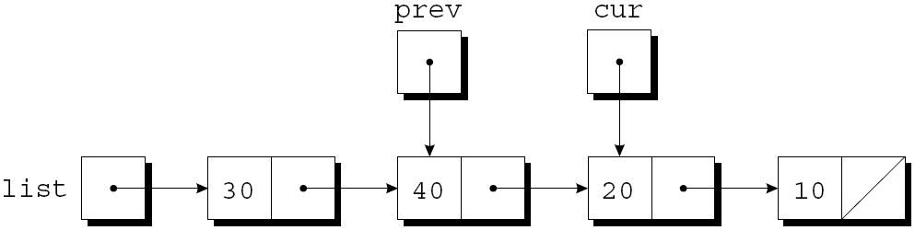
Deleting a Node from a Linked List
The test cur != NULL && cur->value != n is again true, so prev = cur, cur = cur->next is executed once more:
Since cur now points to the node containing 20, the condition cur->value != n is false and the loop terminates.
*
Copyright © 2008 W. W. Norton & Company.
All rights reserved.

Slide 66
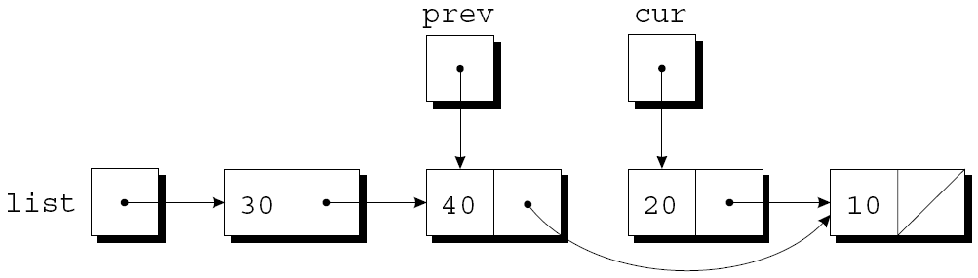
Deleting a Node from a Linked List
Next, we’ll perform the bypass required by step 2.
The statement
prev->next = cur->next;
makes the pointer in the previous node point to the node after the current node:
*
Copyright © 2008 W. W. Norton & Company.
All rights reserved.

Slide 67
Deleting a Node from a Linked List
Step 3 is to release the memory occupied by the current node:
free(cur);
*
Copyright © 2008 W. W. Norton & Company.
All rights reserved.

Slide 68
Deleting a Node from a Linked List
The delete_from_list function uses the strategy just outlined.
When given a list and an integer n, the function deletes the first node containing n.
If no node contains n, delete_from_list does nothing.
In either case, the function returns a pointer to the list.
Deleting the first node in the list is a special case that requires a different bypass step.
*
Copyright © 2008 W. W. Norton & Company.
All rights reserved.

Slide 69
Deleting a Node from a Linked List
struct node *delete_from_list(struct node *list, int n)
{
struct node *cur, *prev;
for (cur = list, prev = NULL;
cur != NULL && cur->value != n;
prev = cur, cur = cur->next)
;
if (cur == NULL)
return list; /* n was not found */
if (prev == NULL)
list = list->next; /* n is in the first node */
else
prev->next = cur->next; /* n is in some other node */
free(cur);
return list;
}
*
Copyright © 2008 W. W. Norton & Company.
All rights reserved.

Slide 70
Ordered Lists
When the nodes of a list are kept in order—sorted by the data stored inside the nodes—we say that the list is ordered.
Inserting a node into an ordered list is more difficult, because the node won’t always be put at the beginning of the list.
However, searching is faster: we can stop looking after reaching the point at which the desired node would have been located.
*
Copyright © 2008 W. W. Norton & Company.
All rights reserved.

Slide 71
Program: Maintaining a Parts Database (Revisited)
The inventory2.c program is a modification of the parts database program of Chapter 16, with the database stored in a linked list this time.
Advantages of using a linked list:
No need to put a limit on the size of the database.
Database can easily be kept sorted by part number.
In the original program, the database wasn’t sorted.
*
Copyright © 2008 W. W. Norton & Company.
All rights reserved.

Slide 72
Program: Maintaining a Parts Database (Revisited)
The part structure will contain an additional member (a pointer to the next node):
struct part {
int number;
char name[NAME_LEN+1];
int on_hand;
struct part *next;
};
inventory will point to the first node in the list:
struct part *inventory = NULL;
*
Copyright © 2008 W. W. Norton & Company.
All rights reserved.

Slide 73
Program: Maintaining a Parts Database (Revisited)
Most of the functions in the new program will closely resemble their counterparts in the original program.
find_part and insert will be more complex, however, since we’ll keep the nodes in the inventory list sorted by part number.
*
Copyright © 2008 W. W. Norton & Company.
All rights reserved.

Slide 74
Program: Maintaining a Parts Database (Revisited)
In the original program, find_part returns an index into the inventory array.
In the new program, find_part will return a pointer to the node that contains the desired part number.
If it doesn’t find the part number, find_part will return a null pointer.
*
Copyright © 2008 W. W. Norton & Company.
All rights reserved.

Slide 75
Program: Maintaining a Parts Database (Revisited)
Since the list of parts is sorted, find_part can stop when it finds a node containing a part number that’s greater than or equal to the desired part number.
find_part’s search loop:
for (p = inventory;
p != NULL && number > p->number;
p = p->next)
;
When the loop terminates, we’ll need to test whether the part was found:
if (p != NULL && number == p->number)
return p;
*
Copyright © 2008 W. W. Norton & Company.
All rights reserved.

Slide 76
Program: Maintaining a Parts Database (Revisited)
The original version of insert stores a new part in the next available array element.
The new version must determine where the new part belongs in the list and insert it there.
It will also check whether the part number is already present in the list.
A loop that accomplishes both tasks:
for (cur = inventory, prev = NULL;
cur != NULL && new_node->number > cur->number;
prev = cur, cur = cur->next)
;
*
Copyright © 2008 W. W. Norton & Company.
All rights reserved.

Slide 77
Program: Maintaining a Parts Database (Revisited)
Once the loop terminates, insert will check whether cur isn’t NULL and whether new_node->number equals cur->number.
If both are true, the part number is already in the list.
Otherwise, insert will insert a new node between the nodes pointed to by prev and cur.
This strategy works even if the new part number is larger than any in the list.
Like the original program, this version requires the read_line function of Chapter 16.
*
Copyright © 2008 W. W. Norton & Company.
All rights reserved.

Slide 78
inventory2.c
/* Maintains a parts database (linked list version) */
#include <stdio.h>
#include <stdlib.h>
#include "readline.h"
#define NAME_LEN 25
struct part {
int number;
char name[NAME_LEN+1];
int on_hand;
struct part *next;
};
struct part *inventory = NULL; /* points to first part */
struct part *find_part(int number);
void insert(void);
void search(void);
void update(void);
void print(void);
*
Copyright © 2008 W. W. Norton & Company.
All rights reserved.

Slide 79
/**********************************************************
* main: Prompts user to enter an operation code, then calls a function to perform the requested action. Repeats until the user enters the command 'q'. Prints an error message if the user enters an illegal code.
**********************************************************/
int main(void)
{ char code;
for (;;) {
printf("Enter operation code: "); scanf(" %c", &code);
while (getchar() != '\n') ; /* skips to end of line */
switch (code) {
case 'i': insert(); break;
case 's': search(); break;
case 'u': update(); break;
case 'p': print(); break;
case 'q': return 0;
default: printf("Illegal code\n");
}
printf("\n");
}
}
*
Copyright © 2008 W. W. Norton & Company.
All rights reserved.

Slide 80
/**********************************************************
* find_part: Looks up a part number in the inventory *
* list. Returns a pointer to the node *
* containing the part number; if the part *
* number is not found, returns NULL. *
**********************************************************/
struct part *find_part(int number)
{
struct part *p;
for (p = inventory;
p != NULL && number > p->number;
p = p->next);
if (p != NULL && number == p->number) return p;
return NULL;
}
*
Copyright © 2008 W. W. Norton & Company.
All rights reserved.

Slide 81
/**********************************************************
* insert: Prompts the user for information about a new *
* part and then inserts the part into the *
* inventory list; the list remains sorted by *
* part number. Prints an error message and *
* returns prematurely if the part already exists *
* or space could not be allocated for the part. *
**********************************************************/
void insert(void)
{
struct part *cur, *prev, *new_node;
new_node = malloc(sizeof(struct part));
if (new_node == NULL) {
printf("Database is full; can't add more parts.\n");
return;
}
printf("Enter part number: ");
scanf("%d", &new_node->number);
*
Copyright © 2008 W. W. Norton & Company.
All rights reserved.

Slide 82
for (cur = inventory, prev = NULL;
cur != NULL && new_node->number > cur->number;
prev = cur, cur = cur->next)
;
if (cur != NULL && new_node->number == cur->number) {
printf("Part already exists.\n");
free(new_node);
return;
}
printf("Enter part name: ");
read_line(new_node->name, NAME_LEN);
printf("Enter quantity on hand: ");
scanf("%d", &new_node->on_hand);
new_node->next = cur;
if (prev == NULL)
inventory = new_node;
else
prev->next = new_node;
}
*
Copyright © 2008 W. W. Norton & Company.
All rights reserved.

Slide 83
/**********************************************************
* search: Prompts the user to enter a part number, then *
* looks up the part in the database. If the part *
* exists, prints the name and quantity on hand; *
* if not, prints an error message. *
**********************************************************/
void search(void)
{
int number;
struct part *p;
printf("Enter part number: ");
scanf("%d", &number);
p = find_part(number);
if (p != NULL) {
printf("Part name: %s\n", p->name);
printf("Quantity on hand: %d\n", p->on_hand);
} else
printf("Part not found.\n");
}
*
Copyright © 2008 W. W. Norton & Company.
All rights reserved.

Slide 84
/**********************************************************
* update: Prompts the user to enter a part number. *
* Prints an error message if the part doesn't *
* exist; otherwise, prompts the user to enter *
* change in quantity on hand and updates the *
* database. *
**********************************************************/
void update(void)
{
int number, change;
struct part *p;
printf("Enter part number: ");
scanf("%d", &number);
p = find_part(number);
if (p != NULL) {
printf("Enter change in quantity on hand: ");
scanf("%d", &change);
p->on_hand += change;
} else
printf("Part not found.\n");
}
*
Copyright © 2008 W. W. Norton & Company.
All rights reserved.

Slide 85
/**********************************************************
* print: Prints a listing of all parts in the database, *
* showing the part number, part name, and *
* quantity on hand. Part numbers will appear in *
* ascending order. *
**********************************************************/
void print(void)
{
struct part *p;
printf("Part Number Part Name "
"Quantity on Hand\n");
for (p = inventory; p != NULL; p = p->next)
printf("%7d %-25s%11d\n",
p->number, p->name, p->on_hand);
}
*
Copyright © 2008 W. W. Norton & Company.
All rights reserved.

Slide 86
Pointers to Pointers
Chapter 13 introduced the idea of a pointer to a pointer.
The concept of “pointers to pointers” also pops up frequently in the context of linked data structures.
In particular, when an argument to a function is a pointer variable, we may want the function to be able to modify the variable.
Doing so requires the use of a pointer to a pointer.
*
Copyright © 2008 W. W. Norton & Company.
All rights reserved.

Slide 87
Pointers to Pointers
The add_to_list function is passed a pointer to the first node in a list; it returns a pointer to the first node in the updated list:
struct node *add_to_list(struct node *list, int n)
{
struct node *new_node;
new_node = malloc(sizeof(struct node));
if (new_node == NULL) {
printf("Error: malloc failed in add_to_list\n");
exit(EXIT_FAILURE);
}
new_node->value = n;
new_node->next = list;
return new_node;
}
*
Copyright © 2008 W. W. Norton & Company.
All rights reserved.

Slide 88
Pointers to Pointers
Modifying add_to_list so that it assigns new_node to list instead of returning new_node doesn’t work.
Example:
add_to_list(first, 10);
At the point of the call, first is copied into list.
If the function changes the value of list, making it point to the new node, first is not affected.
*
Copyright © 2008 W. W. Norton & Company.
All rights reserved.

Slide 89
Pointers to Pointers
Getting add_to_list to modify first requires passing add_to_list a pointer to first:
void add_to_list(struct node **list, int n)
{
struct node *new_node;
new_node = malloc(sizeof(struct node));
if (new_node == NULL) {
printf("Error: malloc failed in add_to_list\n");
exit(EXIT_FAILURE);
}
new_node->value = n;
new_node->next = *list;
*list = new_node;
}
*
Copyright © 2008 W. W. Norton & Company.
All rights reserved.

Slide 90
Pointers to Pointers
When the new version of add_to_list is called, the first argument will be the address of first:
add_to_list(&first, 10);
Since list is assigned the address of first, we can use *list as an alias for first.
In particular, assigning new_node to *list will modify first.
*
Copyright © 2008 W. W. Norton & Company.
All rights reserved.

Slide 91
Pointers to Functions
C doesn’t require that pointers point only to data; it’s also possible to have pointers to functions.
Functions occupy memory locations, so every function has an address.
We can use function pointers in much the same way we use pointers to data.
Passing a function pointer as an argument is fairly common.
*
Copyright © 2008 W. W. Norton & Company.
All rights reserved.

Slide 92
Function Pointers as Arguments
A function named integrate that integrates a mathematical function f can be made as general as possible by passing f as an argument.
Prototype for integrate :
double integrate(double (*f)(double),
double a, double b);
The parentheses around *f indicate that f is a pointer to a function.
An alternative prototype:
double integrate(double f(double),
double a, double b);
*
Copyright © 2008 W. W. Norton & Company.
All rights reserved.

Slide 93
Function Pointers as Arguments
A call of integrate that integrates the sin (sine) function from 0 to π/2:
result = integrate(sin, 0.0, PI / 2);
When a function name isn’t followed by parentheses, the C compiler produces a pointer to the function.
Within the body of integrate, we can call the function that f points to:
y = (*f)(x);
Writing f(x) instead of (*f)(x) is allowed.
*
Copyright © 2008 W. W. Norton & Company.
All rights reserved.

Slide 94
#define incr 0.001
double integrate(double (*f)(double), double a, double b)
{
double x, sum = 0.0;
int i, num_intervals;
num_intervals = ceil((b - a) / incr);
for (i = 0; i <= num_intervals; i++) {
x = a + i * incr;
sum += f(x) * incr;
}
return sum;
}
*
Copyright © 2008 W. W. Norton & Company.
All rights reserved.

Slide 95
The qsort Function
Some of the most useful functions in the C library require a function pointer as an argument.
One of these is qsort, which belongs to the <stdlib.h> header.
qsort is a general-purpose sorting function that’s capable of sorting any array.
*
Copyright © 2008 W. W. Norton & Company.
All rights reserved.

Slide 96
The qsort Function
qsort must be told how to determine which of two array elements is “smaller.”
This is done by passing qsort a pointer to a comparison function.
When given two pointers p and q to array elements, the comparison function must return an integer that is:
Negative if *p is “less than” *q
Zero if *p is “equal to” *q
Positive if *p is “greater than” *q
*
Copyright © 2008 W. W. Norton & Company.
All rights reserved.

Slide 97
The qsort Function
Prototype for qsort:
void qsort(void *base, size_t nmemb, size_t size,
int (*compar)(const void *, const void *));
base must point to the first element in the array (or the first element in the portion to be sorted).
nmemb is the number of elements to be sorted.
size is the size of each array element, measured in bytes.
compar is a pointer to the comparison function.
*
Copyright © 2008 W. W. Norton & Company.
All rights reserved.

Slide 98
The qsort Function
When qsort is called, it sorts the array into ascending order, calling the comparison function whenever it needs to compare array elements.
A call of qsort that sorts the inventory array of Chapter 16:
qsort(inventory, num_parts,
sizeof(struct part), compare_parts);
compare_parts is a function that compares two part structures.
*
Copyright © 2008 W. W. Norton & Company.
All rights reserved.

Slide 99
The qsort Function
Writing the compare_parts function is tricky.
qsort requires that its parameters have type void *, but we can’t access the members of a part structure through a void * pointer.
To solve the problem, compare_parts will assign its parameters, p and q, to variables of type struct part *.
*
Copyright © 2008 W. W. Norton & Company.
All rights reserved.

Slide 100
The qsort Function
A version of compare_parts that can be used to sort the inventory array into ascending order by part number:
int compare_parts(const void *p, const void *q)
{
const struct part *p1 = p;
const struct part *q1 = q;
if (p1->number < q1->number)
return -1;
else if (p1->number == q1->number)
return 0;
else
return 1;
}
*
Copyright © 2008 W. W. Norton & Company.
All rights reserved.

Slide 101
The qsort Function
Most C programmers would write the function more concisely:
int compare_parts(const void *p, const void *q)
{
if (((struct part *) p)->number <
((struct part *) q)->number)
return -1;
else if (((struct part *) p)->number ==
((struct part *) q)->number)
return 0;
else
return 1;
}
*
Copyright © 2008 W. W. Norton & Company.
All rights reserved.

Slide 102
The qsort Function
compare_parts can be made even shorter by removing the if statements:
int compare_parts(const void *p, const void *q)
{
return ((struct part *) p)->number -
((struct part *) q)->number;
}
*
Copyright © 2008 W. W. Norton & Company.
All rights reserved.

Slide 103
The qsort Function
A version of compare_parts that can be used to sort the inventory array by part name instead of part number:
int compare_parts(const void *p, const void *q)
{
return strcmp(((struct part *) p)->name,
((struct part *) q)->name);
}
*
Copyright © 2008 W. W. Norton & Company.
All rights reserved.

Slide 104
The qsort Function
Some of the most useful functions in the C library require a function pointer as an argument.
One of these is qsort, which belongs to the <stdlib.h> header.
qsort is a general-purpose sorting function that’s capable of sorting any array.
*
Copyright © 2008 W. W. Norton & Company.
All rights reserved.

Slide 105
The qsort Function
qsort must be told how to determine which of two array elements is “smaller.”
This is done by passing qsort a pointer to a comparison function.
When given two pointers p and q to array elements, the comparison function must return an integer that is:
Negative if *p is “less than” *q
Zero if *p is “equal to” *q
Positive if *p is “greater than” *q
*
Copyright © 2008 W. W. Norton & Company.
All rights reserved.

Slide 106
The qsort Function
Prototype for qsort:
void qsort(void *base, size_t nmemb, size_t size,
int (*compar)(const void *, const void *));
base must point to the first element in the array (or the first element in the portion to be sorted).
nmemb is the number of elements to be sorted.
size is the size of each array element, measured in bytes.
compar is a pointer to the comparison function.
*
Copyright © 2008 W. W. Norton & Company.
All rights reserved.

Slide 107
The qsort Function
When qsort is called, it sorts the array into ascending order, calling the comparison function whenever it needs to compare array elements.
A call of qsort that sorts the inventory array of Chapter 16:
qsort(inventory, num_parts,
sizeof(struct part), compare_parts);
compare_parts is a function that compares two part structures.
*
Copyright © 2008 W. W. Norton & Company.
All rights reserved.

Slide 108
The qsort Function
Writing the compare_parts function is tricky.
qsort requires that its parameters have type void *, but we can’t access the members of a part structure through a void * pointer.
To solve the problem, compare_parts will assign its parameters, p and q, to variables of type struct part *.
*
Copyright © 2008 W. W. Norton & Company.
All rights reserved.

Slide 109
The qsort Function
A version of compare_parts that can be used to sort the inventory array into ascending order by part number:
int compare_parts(const void *p, const void *q)
{
const struct part *p1 = p;
const struct part *q1 = q;
if (p1->number < q1->number)
return -1;
else if (p1->number == q1->number)
return 0;
else
return 1;
}
*
Copyright © 2008 W. W. Norton & Company.
All rights reserved.

Slide 110
The qsort Function
Most C programmers would write the function more concisely:
int compare_parts(const void *p, const void *q)
{
if (((struct part *) p)->number <
((struct part *) q)->number)
return -1;
else if (((struct part *) p)->number ==
((struct part *) q)->number)
return 0;
else
return 1;
}
*
Copyright © 2008 W. W. Norton & Company.
All rights reserved.

Slide 111
The qsort Function
compare_parts can be made even shorter by removing the if statements:
int compare_parts(const void *p, const void *q)
{
return ((struct part *) p)->number -
((struct part *) q)->number;
}
*
Copyright © 2008 W. W. Norton & Company.
All rights reserved.

Slide 112
The qsort Function
A version of compare_parts that can be used to sort the inventory array by part name instead of part number:
int compare_parts(const void *p, const void *q)
{
return strcmp(((struct part *) p)->name,
((struct part *) q)->name);
}
*
Copyright © 2008 W. W. Norton & Company.
All rights reserved.

Slide 113
The qsort Function
Some of the most useful functions in the C library require a function pointer as an argument.
One of these is qsort, which belongs to the <stdlib.h> header.
qsort is a general-purpose sorting function that’s capable of sorting any array.
*
Copyright © 2008 W. W. Norton & Company.
All rights reserved.

Slide 114
The qsort Function
qsort must be told how to determine which of two array elements is “smaller.”
This is done by passing qsort a pointer to a comparison function.
When given two pointers p and q to array elements, the comparison function must return an integer that is:
Negative if *p is “less than” *q
Zero if *p is “equal to” *q
Positive if *p is “greater than” *q
*
Copyright © 2008 W. W. Norton & Company.
All rights reserved.

Slide 115
The qsort Function
Prototype for qsort:
void qsort(void *base, size_t nmemb, size_t size,
int (*compar)(const void *, const void *));
base must point to the first element in the array (or the first element in the portion to be sorted).
nmemb is the number of elements to be sorted.
size is the size of each array element, measured in bytes.
compar is a pointer to the comparison function.
*
Copyright © 2008 W. W. Norton & Company.
All rights reserved.

Slide 116
The qsort Function
When qsort is called, it sorts the array into ascending order, calling the comparison function whenever it needs to compare array elements.
A call of qsort that sorts the inventory array of Chapter 16:
qsort(inventory, num_parts,
sizeof(struct part), compare_parts);
compare_parts is a function that compares two part structures.
*
Copyright © 2008 W. W. Norton & Company.
All rights reserved.

Slide 117
The qsort Function
Writing the compare_parts function is tricky.
qsort requires that its parameters have type void *, but we can’t access the members of a part structure through a void * pointer.
To solve the problem, compare_parts will assign its parameters, p and q, to variables of type struct part *.
*
Copyright © 2008 W. W. Norton & Company.
All rights reserved.

Slide 118
The qsort Function
A version of compare_parts that can be used to sort the inventory array into ascending order by part number:
int compare_parts(const void *p, const void *q)
{
const struct part *p1 = p;
const struct part *q1 = q;
if (p1->number < q1->number)
return -1;
else if (p1->number == q1->number)
return 0;
else
return 1;
}
*
Copyright © 2008 W. W. Norton & Company.
All rights reserved.

Slide 119
The qsort Function
Most C programmers would write the function more concisely:
int compare_parts(const void *p, const void *q)
{
if (((struct part *) p)->number <
((struct part *) q)->number)
return -1;
else if (((struct part *) p)->number ==
((struct part *) q)->number)
return 0;
else
return 1;
}
*
Copyright © 2008 W. W. Norton & Company.
All rights reserved.

Slide 120
The qsort Function
compare_parts can be made even shorter by removing the if statements:
int compare_parts(const void *p, const void *q)
{
return ((struct part *) p)->number -
((struct part *) q)->number;
}
*
Copyright © 2008 W. W. Norton & Company.
All rights reserved.

Slide 121
The qsort Function
A version of compare_parts that can be used to sort the inventory array by part name instead of part number:
int compare_parts(const void *p, const void *q)
{
return strcmp(((struct part *) p)->name,
((struct part *) q)->name);
}
*
Copyright © 2008 W. W. Norton & Company.
All rights reserved.

Slide 122
Other Uses of Function Pointers
Although function pointers are often used as arguments, that’s not all they’re good for.
C treats pointers to functions just like pointers to data.
They can be stored in variables or used as elements of an array or as members of a structure or union.
It’s even possible for functions to return function pointers.
*
Copyright © 2008 W. W. Norton & Company.
All rights reserved.

Slide 123
Other Uses of Function Pointers
A variable that can store a pointer to a function with an int parameter and a return type of void:
void (*pf)(int);
If f is such a function, we can make pf point to f in the following way:
pf = f;
We can now call f by writing either
(*pf)(i);
or
pf(i);
*
Copyright © 2008 W. W. Norton & Company.
All rights reserved.

Slide 124
Other Uses of Function Pointers
An array whose elements are function pointers:
void (*file_cmd[])(void) = {new_cmd,
open_cmd,
close_cmd,
close_all_cmd,
save_cmd,
save_as_cmd,
save_all_cmd,
print_cmd,
exit_cmd
};
*
Copyright © 2008 W. W. Norton & Company.
All rights reserved.

Slide 125
Other Uses of Function Pointers
A call of the function stored in position n of the file_cmd array:
(*file_cmd[n])(); /* or file_cmd[n](); */
We could get a similar effect with a switch statement, but using an array of function pointers provides more flexibility.
*
Copyright © 2008 W. W. Norton & Company.
All rights reserved.

Slide 126
Program: Tabulating the Trigonometric Functions
The tabulate.c program prints tables showing the values of the cos, sin, and tan functions.
The program is built around a function named tabulate that, when passed a function pointer f, prints a table showing the values of f.
tabulate uses the ceil function.
When given an argument x of double type, ceil returns the smallest integer that’s greater than or equal to x.
*
Copyright © 2008 W. W. Norton & Company.
All rights reserved.

Slide 127
Program: Tabulating the Trigonometric Functions
A session with tabulate.c:
Enter initial value: 0
Enter final value: .5
Enter increment: .1
x cos(x)
------- -------
0.00000 1.00000
0.10000 0.99500
0.20000 0.98007
0.30000 0.95534
0.40000 0.92106
0.50000 0.87758
*
Copyright © 2008 W. W. Norton & Company.
All rights reserved.

Slide 128
Program: Tabulating the Trigonometric Functions
x sin(x)
------- -------
0.00000 0.00000
0.10000 0.09983
0.20000 0.19867
0.30000 0.29552
0.40000 0.38942
0.50000 0.47943
x tan(x)
------- -------
0.00000 0.00000
0.10000 0.10033
0.20000 0.20271
0.30000 0.30934
0.40000 0.42279
0.50000 0.54630
*
Copyright © 2008 W. W. Norton & Company.
All rights reserved.

Slide 129
tabulate.c
/* Tabulates values of trigonometric functions */
#include <math.h>
#include <stdio.h>
void tabulate(double (*f)(double), double first,
double last, double incr);
int main(void)
{
double final, increment, initial;
printf("Enter initial value: ");
scanf("%lf", &initial);
printf("Enter final value: ");
scanf("%lf", &final);
printf("Enter increment: ");
scanf("%lf", &increment);
*
Copyright © 2008 W. W. Norton & Company.
All rights reserved.

Slide 130
printf("\n x cos(x)"
"\n ------- -------\n");
tabulate(cos, initial, final, increment);
printf("\n x sin(x)"
"\n ------- -------\n");
tabulate(sin, initial, final, increment);
printf("\n x tan(x)"
"\n ------- -------\n");
tabulate(tan, initial, final, increment);
return 0;
}
void tabulate(double (*f)(double), double first,
double last, double incr)
{
double x;
int i, num_intervals;
num_intervals = ceil((last - first) / incr);
for (i = 0; i <= num_intervals; i++) {
x = first + i * incr;
printf("%10.5f %10.5f\n", x, (*f)(x));
}
}
*
Copyright © 2008 W. W. Norton & Company.
All rights reserved.

Slide 131
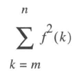
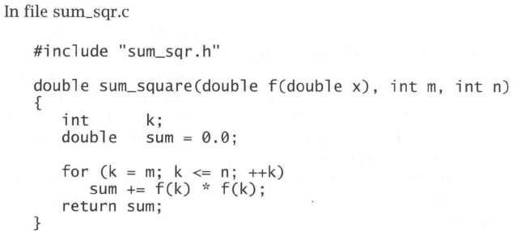
Function as Arguments
*

Slide 132
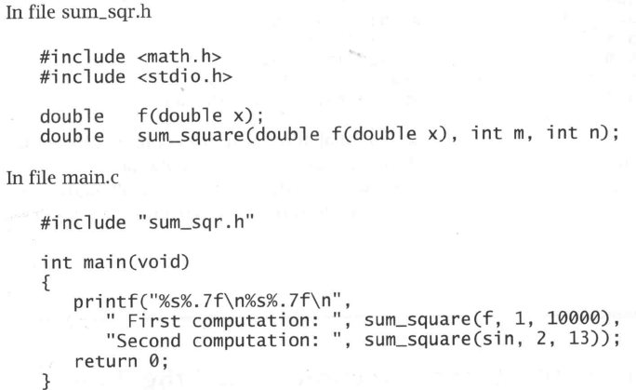
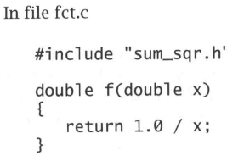
*

Slide 133
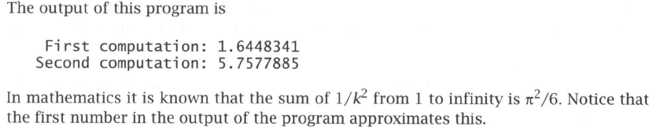
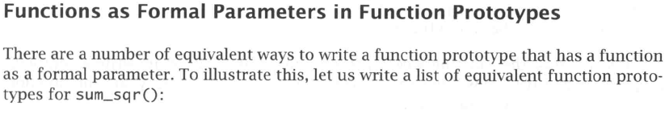
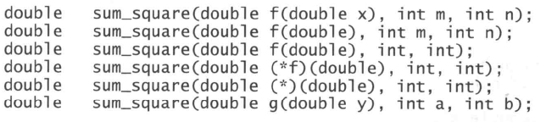
*

Slide 134
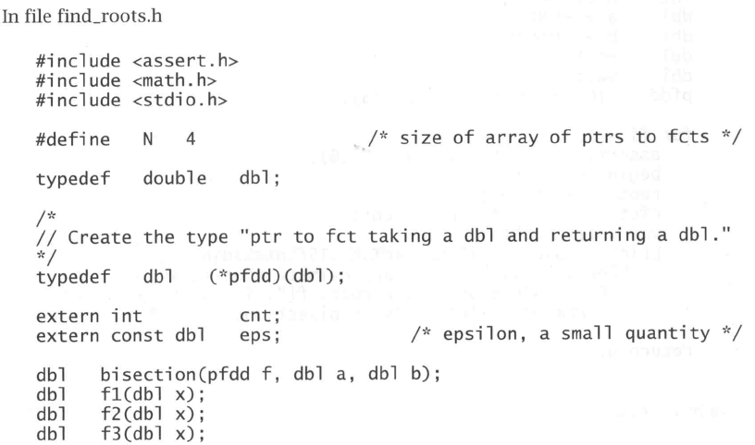
Arrays of Pointers to Function
*

Slide 135
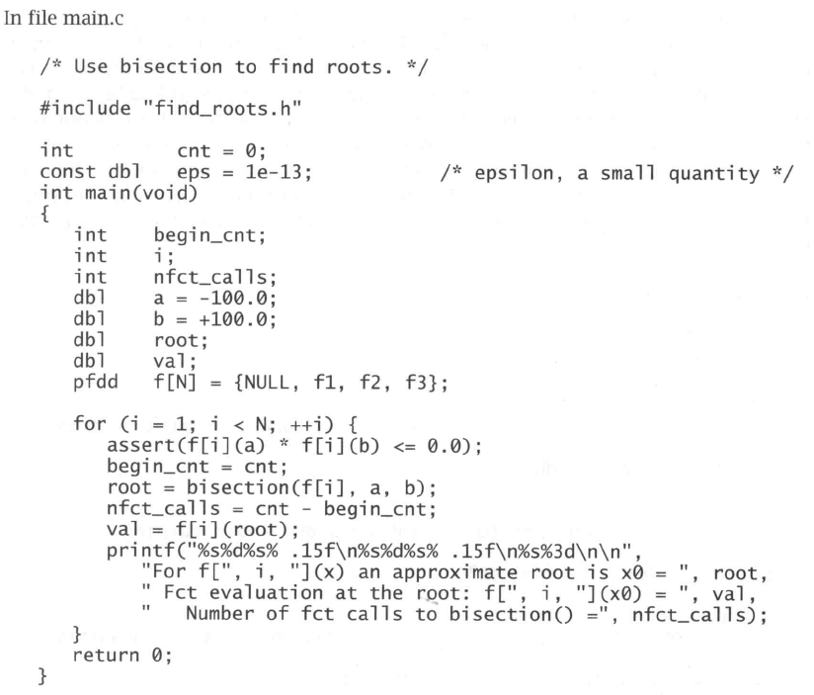
*

Slide 136
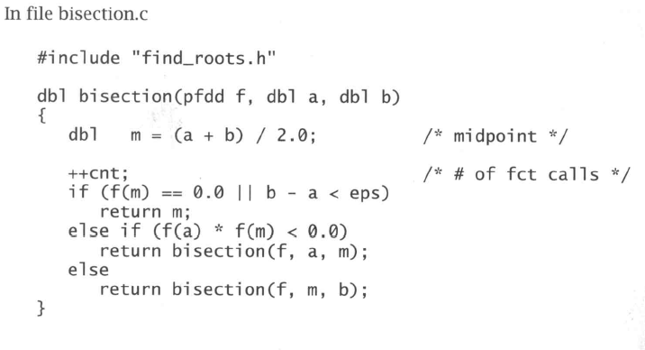
*

Slide 137
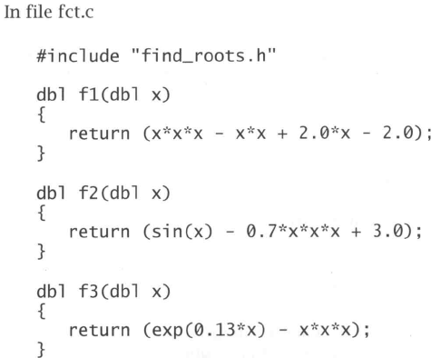
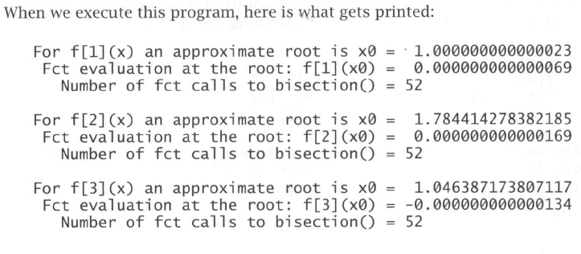
*

Slide 138
Restricted Pointers (C99)
In C99, the keyword restrict may appear in the declaration of a pointer:
int * restrict p;
p is said to be a restricted pointer.
The intent is that if p points to an object that is later modified, then that object is not accessed in any way other than through p.
Having more than one way to access an object is often called aliasing.
*
Copyright © 2008 W. W. Norton & Company.
All rights reserved.

Slide 139
Restricted Pointers (C99)
If the compiler knows that there is only one pointer to a memory block, it can produce better optimized code.
For instance: (no restrict is used)
updatePtrs(size_t *ptrA, size_t *ptrB, size_t *val)
{
*ptrA += *val;
*ptrB += *val;
}
*
Copyright © 2008 W. W. Norton & Company.
All rights reserved.

Slide 140
Restricted Pointers (C99)
In the above code, the pointers ptrA, ptrB, and val might refer to the same memory location, so the compiler may generate less optimal code:
In above code, ptrA/ptrB/val might refer to the same memory location, so compiler may generate less optimal code:
load R1 ← *val ; Load the value of val pointer
load R2 ← *ptrA ; Load the value of ptrA pointer
add R2 += R1 ; Perform Addition
set R2 → *ptrA ; Update the value of ptrA pointer
; Similarly for ptrB, note that val is loaded twice, because
; ptrA may be equal to val (i.e., point to the same location).
load R1 ← *val
load R2 ← *ptrB
add R2 += R1
set R2 → *ptrB
*
Copyright © 2008 W. W. Norton & Company.
All rights reserved.

Slide 141
Restricted Pointers (C99)
In the above code, the pointers ptrA, ptrB, and val might refer to the same memory location, so the compiler may generate less optimal code:
However, if the restrict keyword is used and the above function is declared as
void updatePtrs(size_t *restrict ptrA, size_t *restrict ptrB, size_t *restrict val);
then the compiler is allowed to assume that ptrA, ptrB, and val point to different locations and updating one pointer will not affect the other pointers. The programmer, not the compiler, is responsible for ensuring that the pointers do not point to identical locations.
*
Copyright © 2008 W. W. Norton & Company.
All rights reserved.

Slide 142
Restricted Pointers (C99)
In the above code, the pointers ptrA, ptrB, and val might refer to the same memory location, so the compiler may generate less optimal code:
Now compiler can generate better code (assembly code is shorter because val is loaded once):
load R1 ← *val
load R2 ← *ptrA
add R2 += R1
set R2 → *ptrA
; Note that val is not reloaded,
; because the compiler knows it is unchanged
load R2 ← *ptrB
add R2 += R1
set R2 → *ptrB
*
Copyright © 2008 W. W. Norton & Company.
All rights reserved.

Slide 143
Restricted Pointers (C99)
Consider the following code:
int * restrict p;
int * restrict q;
p = malloc(sizeof(int));
Normally it would be legal to copy p into q and then modify the integer through q:
q = p;
*q = 0; /* causes undefined behavior */
Because p is a restricted pointer, the effect of executing the statement *q = 0; is undefined.
*
Copyright © 2008 W. W. Norton & Company.
All rights reserved.

Slide 144
Restricted Pointers (C99)
// gcc –std=c99 -o restrict-test restrict-test.c
#include <stdio.h>
#include <stdlib.h>
int main(int argc, char *argv[])
{
int *restrict p=(int *) malloc(sizeof(int));
int *restrict q;
*p = 1;
printf("*p = %d\n", *p);
q = p;
*q = 0; /* causes undefined behavior */
printf("*q = %d\n", *q);
}
*
Copyright © 2008 W. W. Norton & Company.
All rights reserved.

Slide 145
Restricted Pointers (C99)
To illustrate the use of restrict, consider the memcpy and memmove functions.
The C99 prototype for memcpy, which copies bytes from one object (pointed to by s2) to another (pointed to by s1):
void *memcpy(void * restrict s1,
const void * restrict s2,
size_t n);
The use of restrict with both s1 and s2 indicates that the objects to which they point shouldn’t overlap.
*
Copyright © 2008 W. W. Norton & Company.
All rights reserved.

Slide 146
Restricted Pointers (C99)
In contrast, restrict doesn’t appear in the prototype for memmove:
void *memmove(void *s1, const void *s2,
size_t n);
memmove is similar to memcpy, but is guaranteed to work even if the source and destination overlap.
Example of using memmove to shift the elements of an array:
int a[100];
…
memmove(&a[0], &a[1], 99 * sizeof(int));
*
Copyright © 2008 W. W. Norton & Company.
All rights reserved.

Slide 147
Restricted Pointers (C99)
Prior to C99, there was no way to document the difference between memcpy and memmove.
The prototypes for the two functions were nearly identical:
void *memcpy(void *s1, const void *s2,
size_t n);
void *memmove(void *s1, const void *s2,
size_t n);
The use of restrict in the C99 version of memcpy’s prototype is a warning that the s1 and s2 objects should not overlap.
*
Copyright © 2008 W. W. Norton & Company.
All rights reserved.

Slide 148
Restricted Pointers (C99)
restrict provides information to the compiler that may enable it to produce more efficient code—a process known as optimization.
The C99 standard guarantees that restrict has no effect on the behavior of a program that conforms to the standard.
Most programmers won’t use restrict unless they’re fine-tuning a program to achieve the best possible performance.
*
Copyright © 2008 W. W. Norton & Company.
All rights reserved.

Slide 149
Flexible Array Members (C99)
Occasionally, we’ll need to define a structure that contains an array of an unknown size.
For example, we might want a structure that stores the characters in a string together with the string’s length:
struct vstring {
int len;
char chars[N];
};
Using a fixed-length array is undesirable: it limits the length of the string and wastes memory.
*
Copyright © 2008 W. W. Norton & Company.
All rights reserved.

Slide 150
Flexible Array Members (C99)
C programmers traditionally solve this problem by declaring the length of chars to be 1 and then dynamically allocating each string:
struct vstring {
int len;
char chars[1];
};
…
struct vstring *str =
malloc(sizeof(struct vstring) + n - 1);
str->len = n;
This technique is known as the “struct hack.”
*
Copyright © 2008 W. W. Norton & Company.
All rights reserved.

Slide 151
Flexible Array Members (C99)
The struct hack is supported by many compilers.
Some (including GCC) even allow the chars array to have zero length.
The C89 standard doesn’t guarantee that the struct hack will work, but a C99 feature known as the flexible array member serves the same purpose.
*
Copyright © 2008 W. W. Norton & Company.
All rights reserved.

Slide 152
Flexible Array Members (C99)
When the last member of a structure is an array, its length may be omitted:
struct vstring {
int len;
char chars[]; /* flexible array member - C99 only */
};
The length of the array isn’t determined until memory is allocated for a vstring structure:
struct vstring *str =
malloc(sizeof(struct vstring) + n);
str->len = n;
sizeof ignores the chars member when computing the size of the structure.
*
Copyright © 2008 W. W. Norton & Company.
All rights reserved.

Slide 153
Flexible Array Members (C99)
Special rules for structures that contain a flexible array member:
The flexible array must be the last member.
The structure must have at least one other member.
Copying a structure that contains a flexible array member will copy the other members but not the flexible array itself.
*
Copyright © 2008 W. W. Norton & Company.
All rights reserved.

Slide 154
Flexible Array Members (C99)
A structure that contains a flexible array member is an incomplete type.
An incomplete type is missing part of the information needed to determine how much memory it requires.
Incomplete types are subject to various restrictions.
In particular, an incomplete type can’t be a member of another structure or an element of an array.
However, an array may contain pointers to structures that have a flexible array member.
*
Copyright © 2008 W. W. Norton & Company.
All rights reserved.

Slide 155
*
Copyright © 2008 W. W. Norton & Company.
All rights reserved.

Slide 156
*
Copyright © 2008 W. W. Norton & Company.
All rights reserved.

Slide 157
*
Copyright © 2008 W. W. Norton & Company.
All rights reserved.

Slide 158
*
Copyright © 2008 W. W. Norton & Company.
All rights reserved.

Slide 159
*
Copyright © 2008 W. W. Norton & Company.
All rights reserved.

Slide 160
*
Copyright © 2008 W. W. Norton & Company.
All rights reserved.

Slide 161
*
Copyright © 2008 W. W. Norton & Company.
All rights reserved.

Slide 162
*
Copyright © 2008 W. W. Norton & Company.
All rights reserved.

Slide 163
*
Copyright © 2008 W. W. Norton & Company.
All rights reserved.

Slide 164
*
Copyright © 2008 W. W. Norton & Company.
All rights reserved.

